Slide 1
TOPIC- DATA STRUCTURE
Presented By-
Mr. Nihar Ranjan Bhuyan
LRDAV Public School, Cuttack

Slide 2
DATA STRUCTURE
Nihar Ranjan Bhuyan, LRDAV Public School

Slide 3
INTRODUCTION
In computer science, a data structure is a collection of data of different data types which is stored in a specific way and can be processed as a single unit.
Data structures provide a means to manage large amounts of data efficiently for uses such as large databases and internet indexing services.
Nihar Ranjan Bhuyan, LRDAV Public School

Slide 4
DIFFERENT DATA STRUCTURE
Data structures are broadly classified in to two types.
1. SIMPLE DATA STRUCTURE
2. COMPOUND DATA STRUCTURE
Nihar Ranjan Bhuyan, LRDAV Public School

Slide 5
1. SIMPLE DATA STRUCTURE
Simple Data structures are also called as primitive data structures and are built from basic data types viz int, float, boolean, characters are called simple data structures.
int
float
boolean
characters
…etc
LINEAR LISTS
Nihar Ranjan Bhuyan, LRDAV Public School

Slide 6
2. COMPOUND DATA STRUCTURE
Compound Data Structure are complex in nature and are classified into two types
1. LINEAR DATA STRUCTURE
2. NON LINEAR DATA STRUCTURE
Nihar Ranjan Bhuyan, LRDAV Public School

Slide 7
1. LINEAR DATA STRUCTURE
A data structure is said to be linear data structure if its elements form a sequence. So these are single level of data structures. For Example:-
LINEAR DATA STRUCTURE
i) STACK
ii) QUEUE
iii) LINKED LIST
Nihar Ranjan Bhuyan, LRDAV Public School

Slide 8
2. NON LINEAR DATA STRUCTURE
A non-linear data structure is a data structure in which a data item is connected to several other data items. So that a given data item has the possibility to reach one-or-more data items.
NON LINEAR DATA STRUCTURE
TREES
Nihar Ranjan Bhuyan, LRDAV Public School

Slide 9
DATA STRUCTURE
SIMPLE DATA
STRUCTURE
COMPOUND DATA
STRUCTURE
LISTS
LINEAR
NON LINEAR
TREES
i) STACK
ii) QUEUE
iii) LINKED LIST
Nihar Ranjan Bhuyan, LRDAV Public School

Slide 10
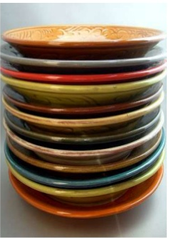
STACKS
In computer science, a stack is a Last In First Out (LIFO) data structure. A stack is dynamic data structure as it can grow or shrink.
Nihar Ranjan Bhuyan, LRDAV Public School

Slide 11
STACK TERMINOLOGIES
The PUSH operation adds an item to the top of the stack.
The POP operation removes an item from the top of the stack.
1. PUSH
2. POP
Nihar Ranjan Bhuyan, LRDAV Public School

Slide 12
STACK TERMINOLOGIES
3. PEEK
It is also called as inspection, refers to inspecting the value at the top of the stack.
Its an Error, when some one tries to push or insert an item in stack that is full.
Its an Error, when some one tries to pop or delete an item from an empty stack.
4. OVER FLOW
5. UNDER FLOW
Nihar Ranjan Bhuyan, LRDAV Public School

Slide 13

Nihar Ranjan Bhuyan, LRDAV Public School

Slide 14
STACK OPERATIONS(PUSH)
67
89
67
95
89
67
TOP
TOP
TOP
TOP=None
PUSH 67
PUSH 89
PUSH 95
Nihar Ranjan Bhuyan, LRDAV Public School

Slide 15
STACK OPERATIONS(POP)
95
89
67
89
67
67
95
89
67
TOP
TOP
TOP
TOP=None
POP
95
POP
89
POP
67
Nihar Ranjan Bhuyan, LRDAV Public School

Slide 16


STACK PROGRAM
Nihar Ranjan Bhuyan, LRDAV Public School

Slide 17
# WAP to implement operations of stack without using predefined functions
stack=[ ]
def getChoice():
print("1.PUSH 2.POP 3.DISPLAY 4.EXIT")
choice = int(input("Enter your choice"))
return choice
def pushitem(item):
stack.append(item)
def popitem():
item=stack[-1]
del stack[-1]
return item
def display():
print('Elements of stack are', stack[::-1])
#Main function starts from here
print("Program starts")
choice = getChoice()
while choice!=4:
if choice==1:
item=int(input("Enter value to push"))
pushitem(item)
elif choice==2:
if(len(stack)!=0):
item=popitem()
print("Popped item= ",item)
else:
print("Stack Underflow")
elif choice==3:
if(len(stack)!=0):
display()
else:
print("Stack Underflow")
else:
print("Wrong Choice")
choice=getChoice()
print("Stack Operations are Over")
Nihar Ranjan Bhuyan, LRDAV Public School

Slide 18
APPLICATIONS OF STACKS
Nihar Ranjan Bhuyan, LRDAV Public School

Slide 19
APPLICATIONS OF STACKS
1. EXPRESSION CONVERSION
2. EXPRESSION EVALUATION
3. PARENTHESIS CHECKING
4. STRING REVERSAL
5. FUNCTION CALL
Nihar Ranjan Bhuyan, LRDAV Public School

Slide 20
APPLICATIONS OF STACKS
1. EXPRESSION CONVERSION
An expression can be represented in prefix, postfix or infix notation.
Stack can be used to convert one form of expression to another.
Nihar Ranjan Bhuyan, LRDAV Public School

Slide 21
DIFFERENT ALGEBRAIC EXPRESSIONS
INFIX EXPRESSION | POSTFIX EXPRESSION
(P+Q)*(M-N) | PQ+MN-*
(P+Q) / (M-N) - (A*B) | PQ+MN-/AB*-
Nihar Ranjan Bhuyan, LRDAV Public School

Slide 22
CONVERSION METHOD
Nihar Ranjan Bhuyan, LRDAV Public School

Slide 23
Converting from Infix to Postfix
Let, X is an arithmetic expression written in infix notation. This algorithm finds the equivalent postfix expression Y.
1. Push “(“ onto Stack, and add “)” to the end of X.
2. Scan X from left to right and repeat Step 3 to 6 for each element of X until the Stack is empty.
3. If an operand is encountered, add it to Y.
4. If a left parenthesis is encountered, push it onto Stack.
5. If an operator is encountered, then:
Repeatedly pop from Stack and add to Y each operator (on the top of Stack) which has the same precedence as or higher precedence than operator.
Add operator to Stack.
6. If a right parenthesis is encountered, then:
Repeatedly pop from Stack and add to Y each operator (on the top of Stack) until a left parenthesis is encountered.
Remove the left Parenthesis.
END.
Nihar Ranjan Bhuyan, LRDAV Public School

Slide 24
CONVERSION – Example 1
Convert the infix expression
(A+B)*(C-D)/E
into postfix expression showing stack status after every step.
Nihar Ranjan Bhuyan, LRDAV Public School

Slide 25
Symbol scanned(X) | Stack status | Postfix expr(Y)
((A+B)*(C-D)/E)
( | (
( | ((
A | (( | A
+ | ((+ | A
B | ((+ | AB
) | ( | AB+
* | (* | AB+
( | (*( | AB+
C | (*( | AB+C
Answer : AB+CD-*E/
- | (*(- | AB+C
D | (*(- | AB+CD
) | (* | AB+CD-
/ | (/ | AB+CD-*
E | (/ | AB+CD-*E
) |  | AB+CD-*E/
Nihar Ranjan Bhuyan, LRDAV Public School

Slide 26
APPLICATIONS OF STACKS
2. EXPRESSION EVALUATION
Stack is used to evaluate prefix, postfix and infix expressions. We will discuss how to evaluate postfix expression.
Nihar Ranjan Bhuyan, LRDAV Public School

Slide 27
POSTFIX EVALUATION – Example 2
Evaluate the following postfix expression showing stack status after every step
8, 2, +, 5, 3, -, *, 4 /
Nihar Ranjan Bhuyan, LRDAV Public School

Slide 28
8, 2, +, 5, 3, -, *, 4 /
scanned | Stack status | Operation performed
8 | 8 | Push 8
2 | 8, 2 | Push 2
+ | 10 | Push(op1+op2) i.e. 8+2
5 | 10, 5 | Push(5)
3 | 10, 5, 3 | Push(3)
- | 10, 2 | Push(op1-op2) i.e. 5-3
Answer : 5
* | 20 | Push(op1-op2) i.e. 10*2
4 | 20, 4 | Push 4
/ | 5 | Push(op1/op2) i.e. 20/4
Nihar Ranjan Bhuyan, LRDAV Public School

Slide 29
POSTFIX EVALUATION – Example 3
Evaluate the following Boolean postfix expression showing stack status after every step.
True, False, True, AND, OR, False, NOT, AND
Nihar Ranjan Bhuyan, LRDAV Public School

Slide 30
True, False, True, AND, OR, False, NOT, AND
Scanned | Stack status | Operation performed
True | True | Push True
False | True, False | Push False
True | True, False, True | Push True
AND | True, False | Push(Op2 AND Op1) i.e. False AND True=False
OR | True | Push(Op2 OR Op1) i.e. True OR False=True
Answer : True
False | True, False | Push False
NOT | True, True | Push(NOT False) i.e. NOT False=True
AND | True | Push(Op2 AND Op1) i.e. True AND True=True
Nihar Ranjan Bhuyan, LRDAV Public School

Slide 31
ASSIGNMENT-1
INFIX EXPRESSIONS INTO POSTFIX
Translate each of the following infix expressions into postfix.
(A * B) / C
(A - (B * C) + D / E
(X - Y) + (W * Z) / V
V * W * X + Y - Z
A / B * C - D + E
Nihar Ranjan Bhuyan, LRDAV Public School

Slide 32
APPLICATIONS OF STACKS
3. PARENTHESIS CHECKING
M
A
L
A
Y
A
L
A
M
Stack is used to check the proper opening and closing of parenthesis.
4. STRING REVERSAL
Stack is used to reverse a string. We push the characters of string one by one into stack and then pop character from stack.
Nihar Ranjan Bhuyan, LRDAV Public School

Slide 33
APPLICATIONS OF STACKS
5. FUNCTION CALL
Stack is used to keep information about the active functions or subroutines.
Let’s Evaluate a Postfix Conversion:
12,7,3,-,/,2,1,5,+,*,+
Nihar Ranjan Bhuyan, LRDAV Public School

Slide 34
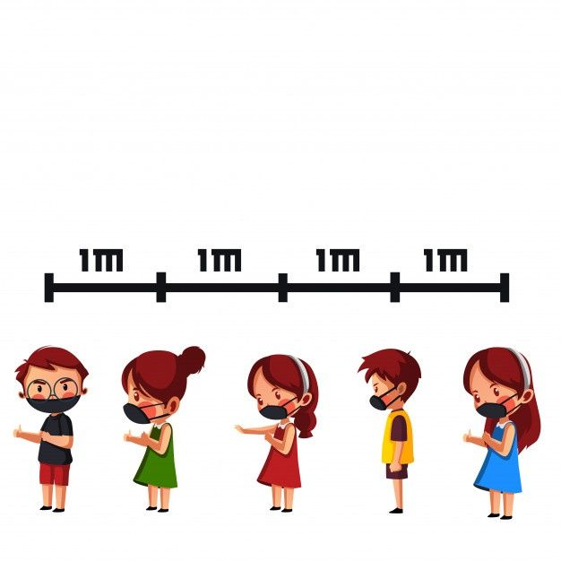
QUEUE
Nihar Ranjan Bhuyan, LRDAV Public School

Slide 35
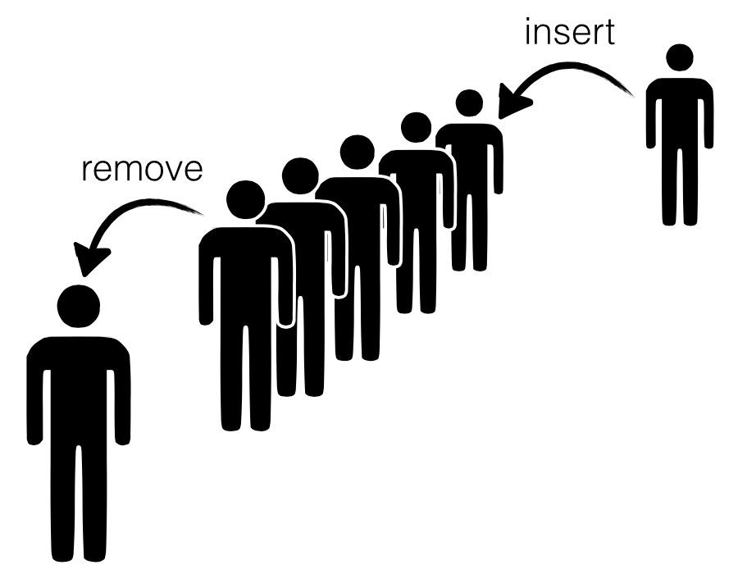
QUEUE
Queue is a linear data structure which follows First In First Out (FIFO) rule in which a new item is added at the rear end and deletion of item is from the front end of the queue. In a FIFO data structure, the first element added to the queue will be the first one to be removed.
Nihar Ranjan Bhuyan, LRDAV Public School

Slide 36
QUEUE TERMINOLOGIES
Nihar Ranjan Bhuyan, LRDAV Public School

Slide 37
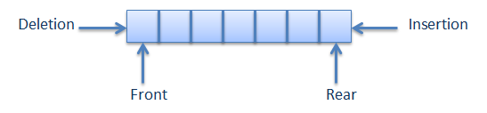
QUEUE TERMINOLOGIES
To add or append or push an item to the REAR of the queue.
To delete or pop or remove an item from the front end of queue.
1. ENQUEUE
2. DEQUEUE
Nihar Ranjan Bhuyan, LRDAV Public School

Slide 38
QUEUE TERMINOLOGIES
3. PEEK
It is also called as inspection, refers to inspecting the value at the front of the queue.
Its an Error, when some one tries to push an item in queue that is full.
Its an Error, when some one tries to pop or delete an item from an empty queue.
4. OVER FLOW
5. UNDER FLOW
Nihar Ranjan Bhuyan, LRDAV Public School

Slide 39

Nihar Ranjan Bhuyan, LRDAV Public School

Slide 40
DIAGRAMATIC REPRESENTATION OF QUEUE
0
1
2
3
4
Now, QUEUE is Empty so,
FRONT = REAR = None
UNDERFLOW
FRONT = REAR = None, so if you try to delete or dequeue, underflow occurs, since there is no element to delete
Nihar Ranjan Bhuyan, LRDAV Public School

Slide 41
DIAGRAMATIC REPRESENTATION OF QUEUE
ENQUEUE
Now, ENQUEUE with 56, then
FRONT = REAR = 0
0
1
2
3
4
FRONT
56
REAR
Nihar Ranjan Bhuyan, LRDAV Public School

Slide 42
DIAGRAMATIC REPRESENTATION OF QUEUE
ENQUEUE
Now, ENQUEUE with 783, then
FRONT = 0 and REAR = 1
0
1
2
3
4
FRONT
56 | 783
REAR
Nihar Ranjan Bhuyan, LRDAV Public School

Slide 43
DIAGRAMATIC REPRESENTATION OF QUEUE
ENQUEUE
Now, ENQUEUE with 126, then
FRONT = 0 and REAR = 2
0
1
2
3
4
FRONT
56 | 783 | 126
REAR
Nihar Ranjan Bhuyan, LRDAV Public School

Slide 44
DIAGRAMATIC REPRESENTATION OF QUEUE
DEQUEUE
Now, DEQUEUE, then
FRONT = 1 and REAR = 2
0
1
2
3
4
 | 783 | 126
FRONT
REAR
Nihar Ranjan Bhuyan, LRDAV Public School

Slide 45
DIAGRAMATIC REPRESENTATION OF QUEUE
ENQUEUE
Now, ENQUEUE with 654, then
FRONT = 1 and REAR = 3
0
1
2
3
4
 | 783 | 126 | 654
FRONT
REAR
Nihar Ranjan Bhuyan, LRDAV Public School

Slide 46
DIAGRAMATIC REPRESENTATION OF QUEUE
ENQUEUE
Now, ENQUEUE with 914, then
FRONT = 1 and REAR = 4
0
1
2
3
4
 | 783 | 126 | 654 | 914
FRONT
REAR
Nihar Ranjan Bhuyan, LRDAV Public School

Slide 47
DIAGRAMATIC REPRESENTATION OF QUEUE
ENQUEUE
OVERFLOW
Now, ENQUEUE with 637, then
OVERFLOW occurs since no space to insert in queue.
0
1
2
3
4
 | 783 | 126 | 654 | 914
FRONT
REAR
Nihar Ranjan Bhuyan, LRDAV Public School

Slide 48
SIZE OF QUEUE
Size of queue or Total number of elements can be determined by the following formula:
No of Elements = REAR – FRONT + 1
Nihar Ranjan Bhuyan, LRDAV Public School

Slide 49
# WAP to implement operations of queue without using predefined functions
Queue=[]
def getChoice():
print("1.INSERT 2.DELETE 3.DISPLAY 4.EXIT")
choice = int(input("Enter your choice"))
return choice
def insertitem(item):
Queue.append(item)
def deleteitem():
global Queue
item=Queue[0]
Queue = Queue[1:len(Queue)]
return item
def display():
print ('Elements of Queue are', Queue)
#Main function starts from here
print("Program starts")
choice = getChoice()
while choice!=4:
if choice==1:
item=int(input("Enter value to insert"))
insertitem(item)
elif choice==2:
if(len(Queue) != 0):
item=deleteitem()
print("Deleted item= ",item)
else:
print("Queue Underflow")
elif choice==3:
if(len(Queue) != 0):
display()
else:
print("Queue Underflow")
else:
print("Wrong Choice")
choice=getChoice()
print("Queue Operations are Over")
Nihar Ranjan Bhuyan, LRDAV Public School

Slide 50
APPLICATIONS OF QUEUES
Nihar Ranjan Bhuyan, LRDAV Public School

Slide 51
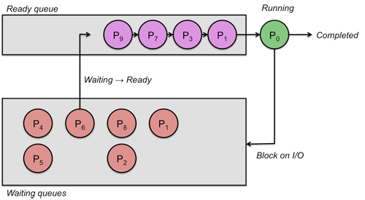
APPLICATIONS OF QUEUES
1. Serving requests on a single shared resource, like a printer.
2. CPU task scheduling.
3. In real life scenario, Call Center phone systems uses Queues to hold people calling them in an order, until a service representative is free.
Nihar Ranjan Bhuyan, LRDAV Public School

Slide 52
APPLICATIONS OF QUEUES
4.When a resource is shared among multiple consumers. Examples include CPU scheduling, Disk Scheduling.
5. Round robin scheduling.
6. Job scheduling.
Nihar Ranjan Bhuyan, LRDAV Public School

Slide 53
Assignment-2
Write AddCustomer(Customer) and DeleteCustomer(Customer) methods in Python to add a new Customer and delete a Customer from a List of CustomerNames, considering them to act as push and pop operations of the stack data structure. (4)
Write a Python program to implement all basic operations of a stack, such as adding element (PUSH operation), removing element (POP operation) and displaying the stack elements (Traversal operation) using lists. (4)
Write a program to perform insert and delete operations on a Queue containing Members details as given in the following definition of item node: Member_No integer ,Member_Name String ,Age integer . (4)
4. Write a program in Python to add, delete and display elements from a queue using list. (4)
Nihar Ranjan Bhuyan, LRDAV Public School

Slide 54
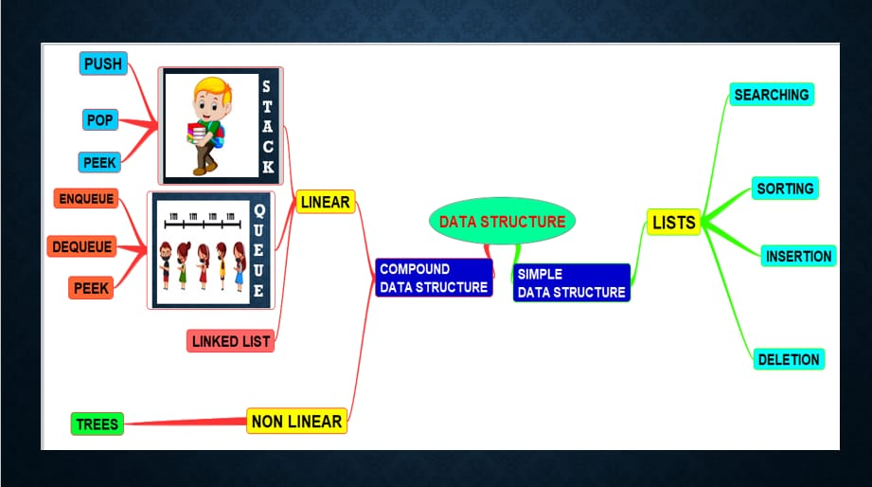
Mind Map
Nihar Ranjan Bhuyan, LRDAV Public School

